Slide 1
Applied Data Science Capstone Project
Recommendation on starting Indian Restaurant in Toronto Neighborhood
By Sudhir Sekuri

Slide 2
Introduction / Business Objective
In 1998, an Indian restaurant 'Fusion of India' ventured into the United States of America market by opening its business in New York city. Though there was another couple of Indian restaurants that already existed nearby in the neighborhood, the business took off successfully due to popular demand of local customers and visitors across the country. Over years, their business expanded with presence in various key cities across the country.¶
With its success story in USA, the restaurant wants to now explore opportunity for growth in different countries. To begin with the nearest neighboring country in North America, it obviously chose Canada for expansion and identified Toronto as its key city. Since this is their first time in the Toronto neighborhood, they are unsure about its market and competition of similar restaurants in area.
Based on lesson learnt with USA market, the restaurant is looking for a recommendation system on a neighborhood where there are good number of venues with respect to shopping, coffee places, fun activities, etc. that doesn't include more than couple of Indian food places.

Slide 3
Recommendation Approach
The Business Objective is analyzed using various steps :
Step 1. Gather and Prepare necessary data.
Step 2. Plot the neighborhoods for visualization.
Step 3. Use Foursquare API in fetching all venues for the neighborhoods and Analyze results to provide recommendation.

Slide 4
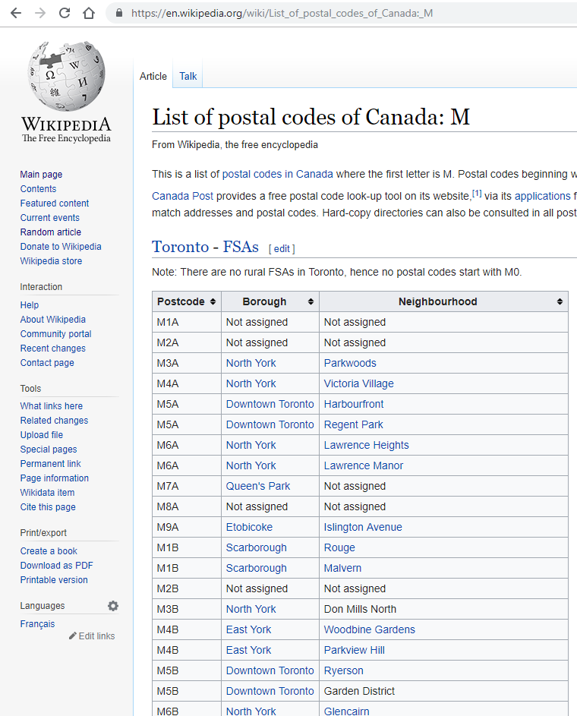
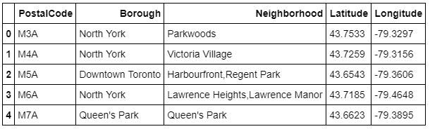
Step 1: Gather and Prepare Data
Gather all Canadian postal codes with their neighborhood details from Wikipedia as shown on right side and scrub to create unique values with concatenated values of different neighborhoods.
Fetch Geospatial data of all the postal codes from url 'http://cocl.us/Geospatial_data’ and merge with above list so that data is ready for our analysis as shown below.
Data Format:

Slide 5
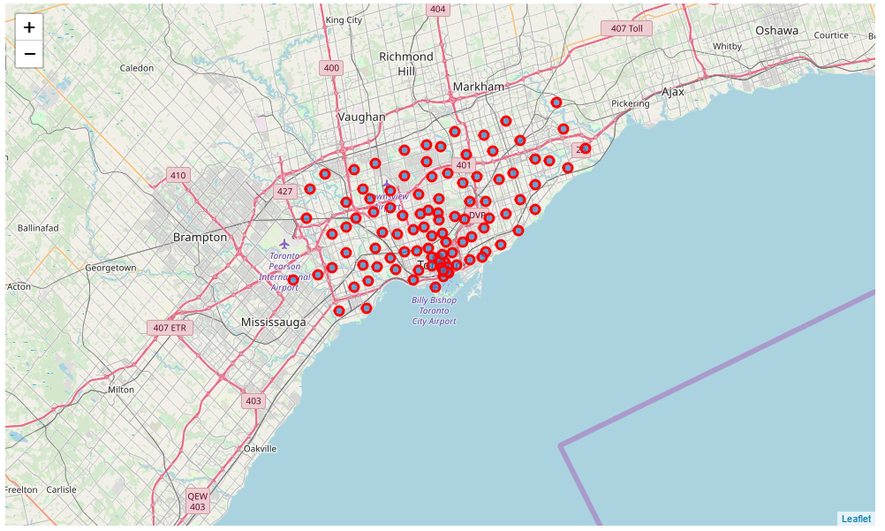
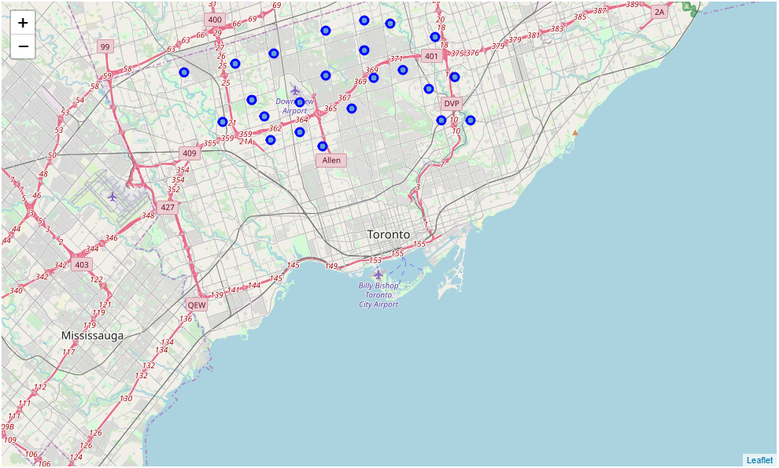
Step 2: Plot Neighborhoods for visualization
All neighborhoods of Toronto
Most Neighborhoods are in North York

Slide 6
Step 3: Results Summary
Summary:
Entire North York borough has only 1 Indian Restaurant in the neighborhood of Bedford Park and Lawrence Manor East belonging to Postal Code M5M.
Neighborhood with most venues in North York are Fairview, Henry Farm and Oriole that belong to Postal Code M2J and doesn’t have an Indian Restaurant.
Results:
Since the above summary meets the business objective, the recommendation to start an Indian Restaurant is in any neighborhood of Fairview, Henry Farm and Oriole that has many different restaurants, café, Bakery, Burger Joints, Sports Shop, Clothing, Electronics, Fast Food, etc.
A quick turnaround can be provided on similar analysis if interest is of any specific Borough with different set of neighborhoods.

